Slide 1
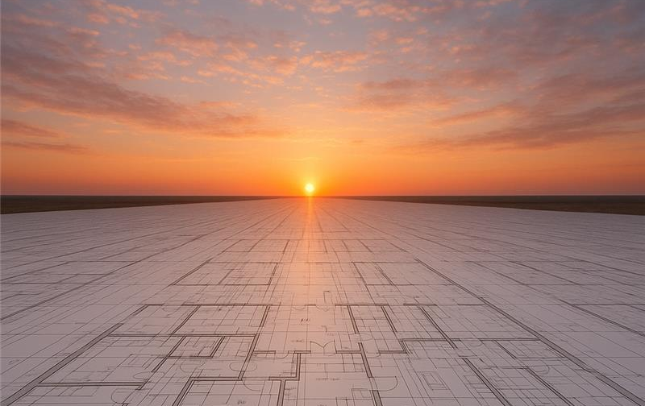

Slide 2


Slide 3
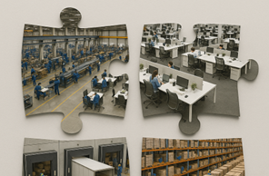
Notes:
Think of your facility as a collection of interconnected functional areas.

Slide 4
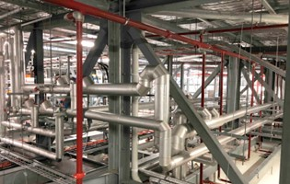
Notes:
Consider essential utilities that are the lifelines of your operation.

Slide 5

Notes:
Compliance with planning and building codes is non-negotiable.

Slide 6

Notes:
Select an experienced project partner.

